Slide 1
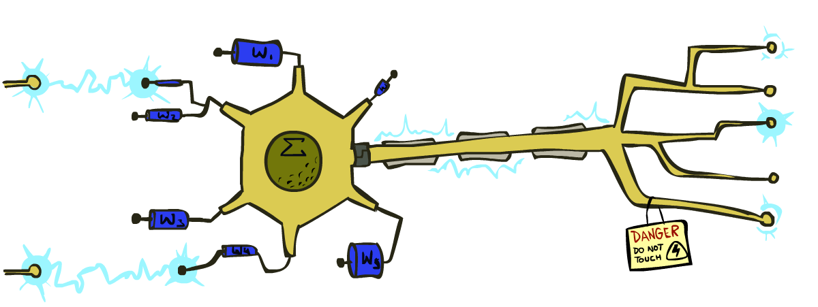
CS 188: Artificial Intelligence
Perceptrons and Logistic Regression
Spring 2023
University of California, Berkeley

Slide 2
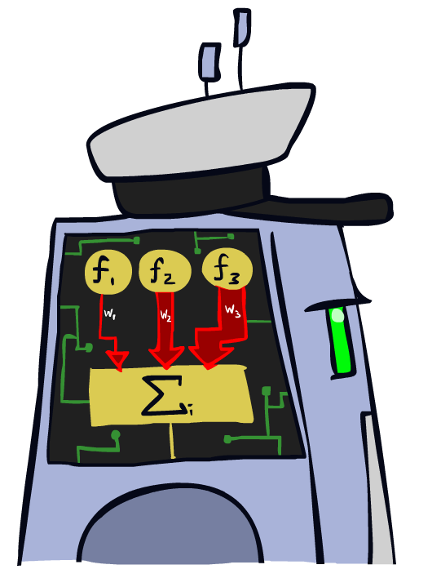
Linear Classifiers

Slide 3
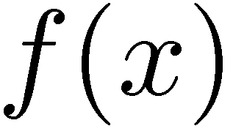

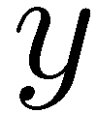

Feature Vectors
Hello,
Do you want free printr cartriges? Why pay more when you can get them ABSOLUTELY FREE! Just
# free : 2
YOUR_NAME : 0
MISSPELLED : 2
FROM_FRIEND : 0
...
SPAM
or
+
PIXEL-7,12 : 1
PIXEL-7,13 : 0
...
NUM_LOOPS : 1
...
“2”

Slide 4
Some (Simplified) Biology
Very loose inspiration: human neurons

Slide 5
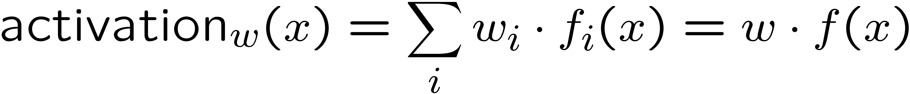
Linear Classifiers
Inputs are feature values
Each feature has a weight
Sum is the activation
If the activation is:
Positive, output +1
Negative, output -1
w₁
f₁
Σ
w₂
>0?
f₂
w₃
f₃

Slide 6
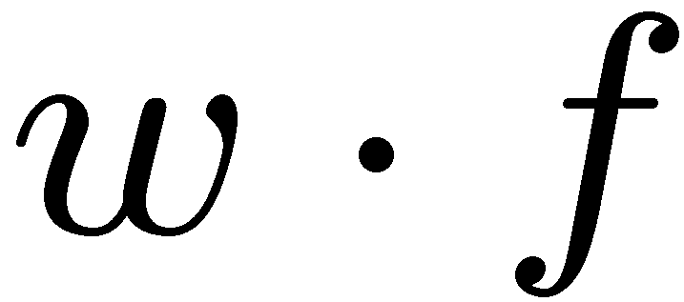
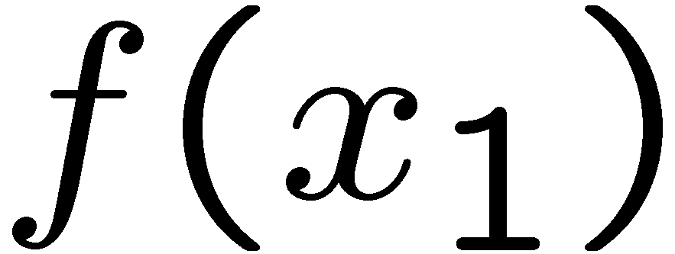

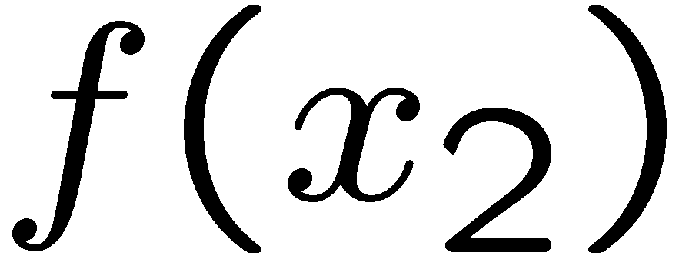
Weights
Dot product positive means the positive class (spam)
# free : 4
YOUR_NAME :-1
MISSPELLED : 1
FROM_FRIEND :-3
...
# free : 2
YOUR_NAME : 0
MISSPELLED : 2
FROM_FRIEND : 0
...
# free : 4
YOUR_NAME :-1
MISSPELLED : 1
FROM_FRIEND :-3
...
# free : 0
YOUR_NAME : 1
MISSPELLED : 1
FROM_FRIEND : 1
...
Do these weights make sense for spam classification?

Slide 7
Review: Vectors
A tuple like (2,3) can be interpreted two different ways:
A tuple with more elements like (2, 7, -3, 6) is a point or vector in higher-dimensional space (hard to visualize)
3
3
2
2
A point on a coordinate grid
A vector in space. Notice we are not on a coordinate grid.

Slide 8
Review: Vectors
Definition of dot product:
a · b = |a| |b| cos(θ)
θ is the angle between the vectors a and b
Consequences of this definition:
Vectors closer together = “similar” vectors = smaller angle θ between vectors = larger (more positive) dot product
If θ < 90°, then dot product is positive
If θ = 90°, then dot product is zero
If θ > 90°, then dot product is negative
θ
θ
a · b large, positive
a · b small, positive
θ
θ
a · b zero
a · b negative

Slide 9
Weights
Binary case: compare features to a weight vector
Learning: figure out the weight vector from examples
# free : 4
YOUR_NAME :-1
MISSPELLED : 1
FROM_FRIEND :-3
...
# free : 2
YOUR_NAME : 0
MISSPELLED : 2
FROM_FRIEND : 0
...
# free : 0
YOUR_NAME : 1
MISSPELLED : 1
FROM_FRIEND : 1
...
Dot product positive means the positive class

Slide 10
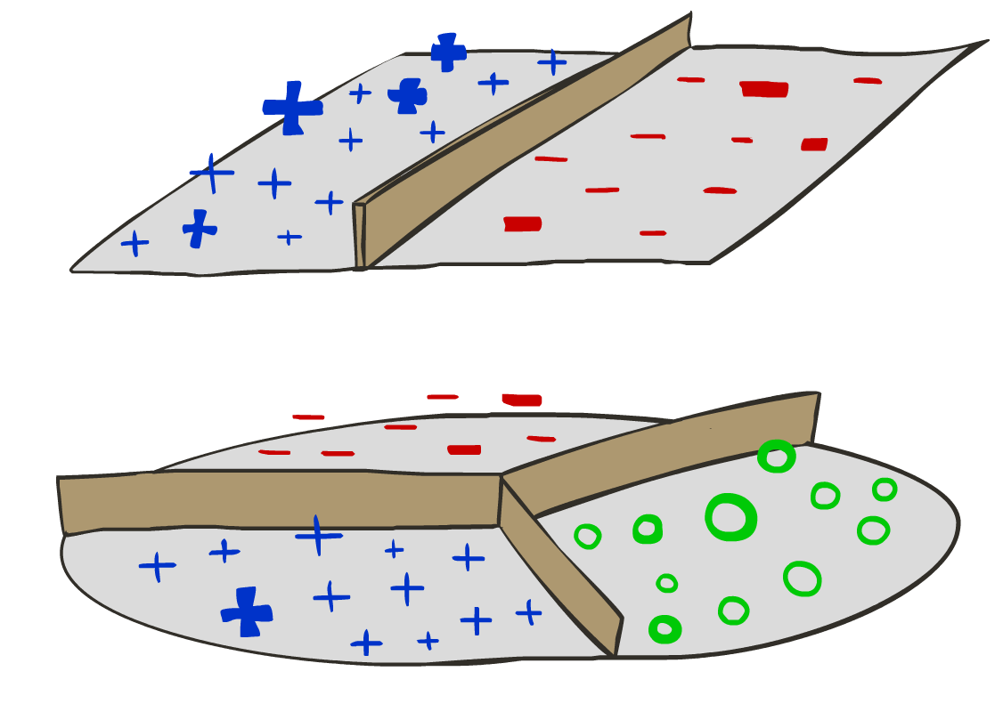
Decision Rules

Slide 11

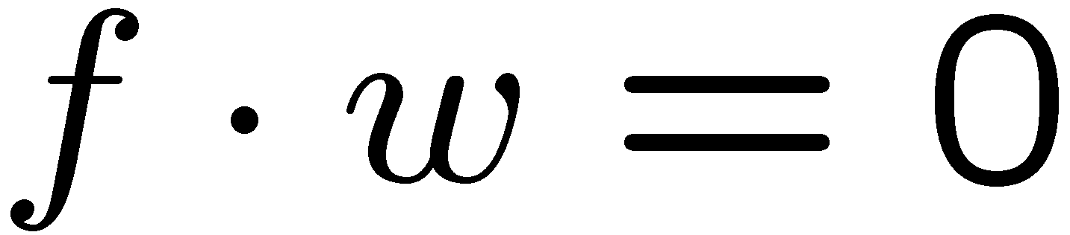
Binary Decision Rule
In the space of feature vectors
Examples are points
Any weight vector is a hyperplane (divides space into two sides)
One side corresponds to Y=+1, the other corresponds to Y=-1
In the example:
f · w > 0 when 4*free + 2*money > 0 f · w < 0 when 4*free + 2*money < 0 These equations correspond to two halves of the feature space
f · w = 0 when 4*free + 2*money = 0 This equation corresponds to the decision boundary (a line in 2D, a hyperplane in higher dimensions)
free : 4
money : 2
2
money
+1 = SPAM
1
0
-1 = HAM
0
1
free

Slide 12
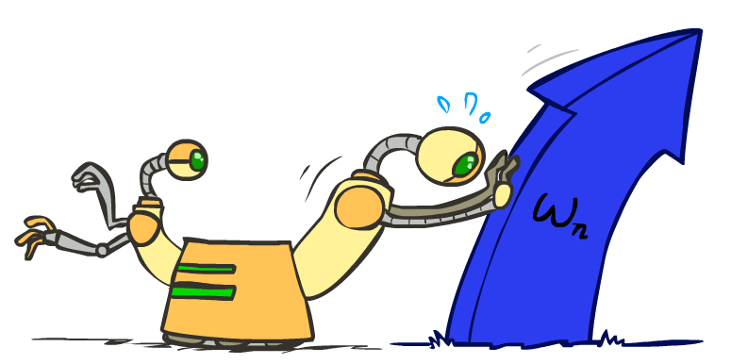
Weight Updates

Slide 13
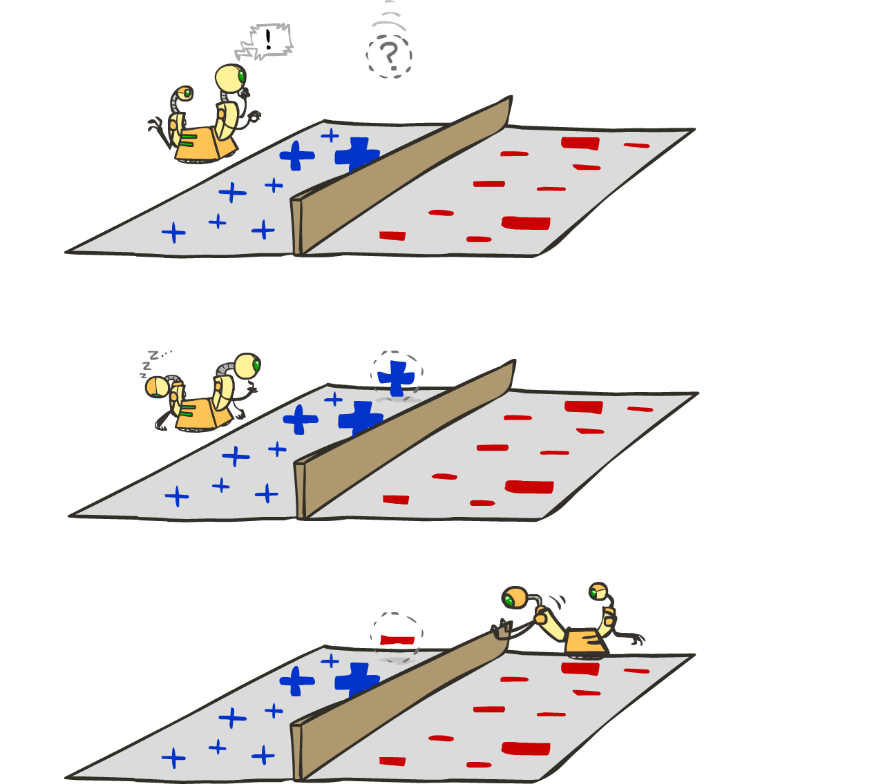
Learning: Binary Perceptron
Start with weights = 0
For each training instance:
Classify with current weights
If correct (i.e., y=y*), no change!
If wrong: adjust the weight vector
Notes:
http://isl.ira.uka.de/neuralNetCourse/2004/VL_11_5/Perceptron.html

Slide 14
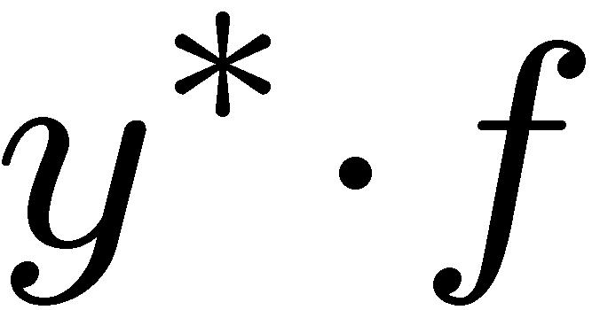
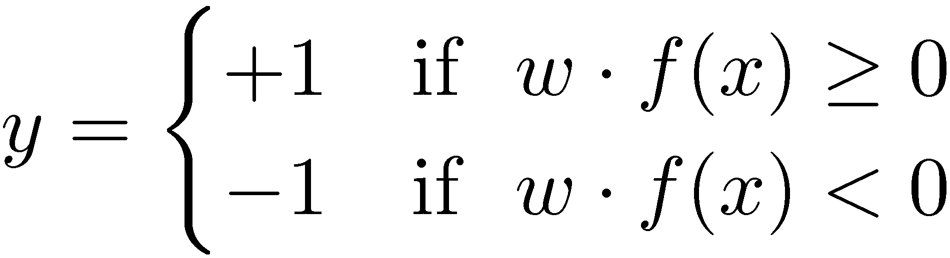

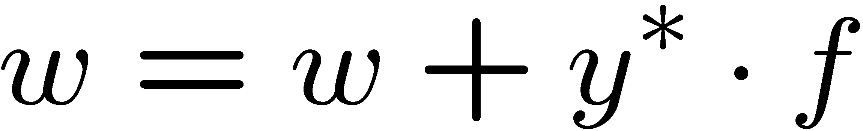
Learning: Binary Perceptron
Start with weights = 0
For each training instance:
Classify with current weights
If correct (i.e., y=y*), no change!
If wrong: adjust the weight vector by adding or subtracting the feature vector. Subtract if y* is -1.
Notes:
http://isl.ira.uka.de/neuralNetCourse/2004/VL_11_5/Perceptron.html

Slide 15
Learning: Binary Perceptron
Misclassification, Case I:
w · f > 0, so we predict +1
True class is -1
We want to modify w to w' such that dot product w' · f is lower
Update if we misclassify a true class -1 sample: w' = w – f
Proof: w' · f = (w – f) · f = (w · f) – (f · f) = (w · f) – |f|² Note that |f|² is always positive
Misclassification, Case II:
w · f < 0, so we predict -1
True class is +1
We want to modify w to w' such that dot product w' · f is higher
Update if we misclassify a true class +1 sample: w' = w + f
Proof: w' · f = (w + f) · f = (w · f) + (f · f) = (w · f) + |f|² Note that |f|² is always positive
Write update compactly as w' = w + y* · f, where y* = true class

Slide 16
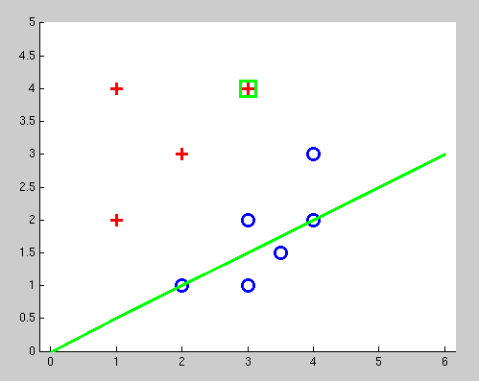
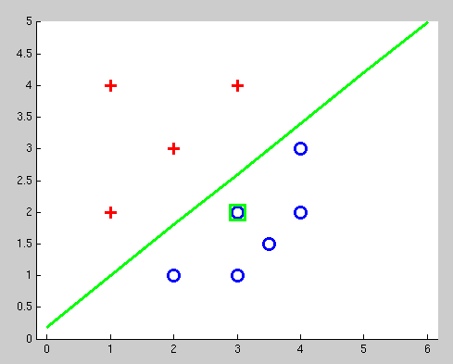
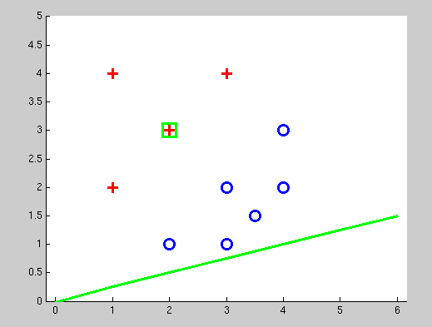
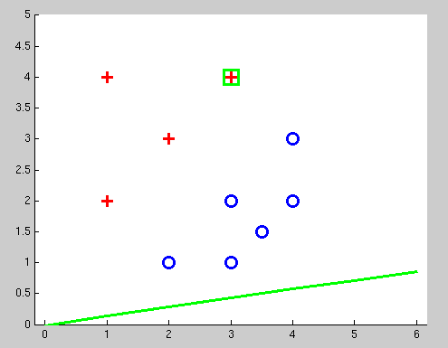
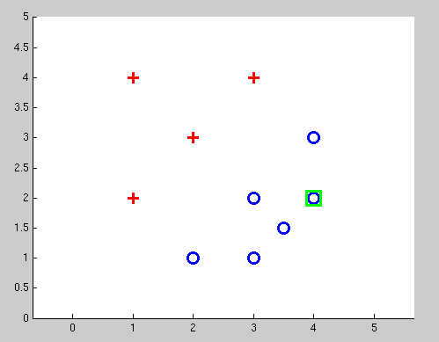
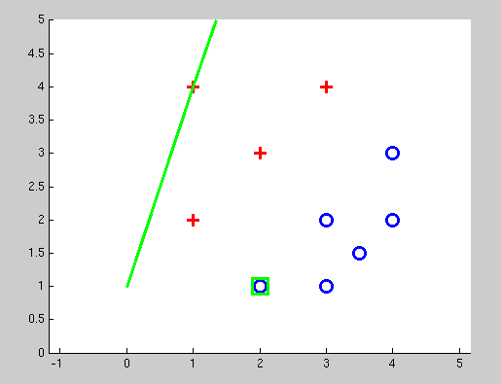
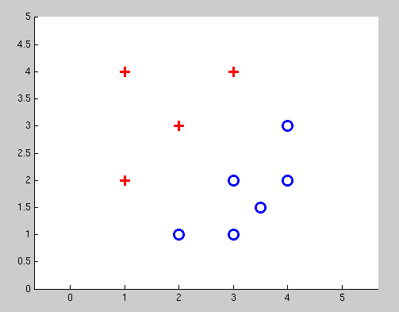
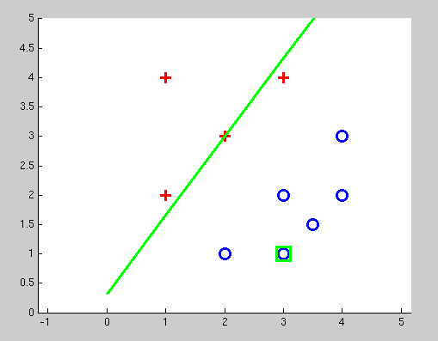
Examples: Perceptron
Separable Case

Slide 17


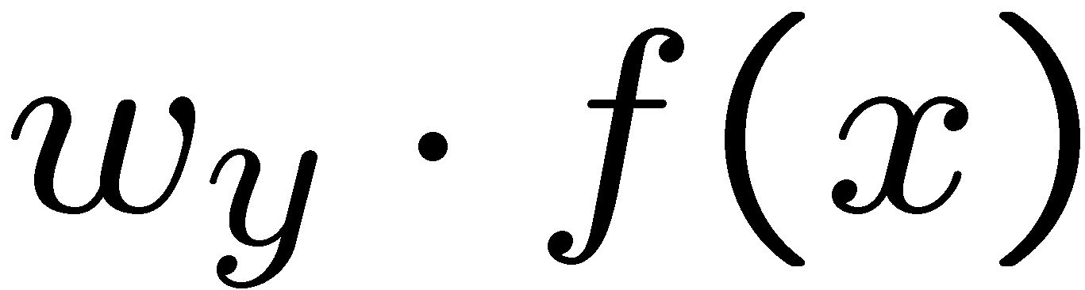


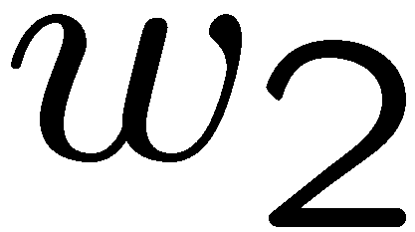
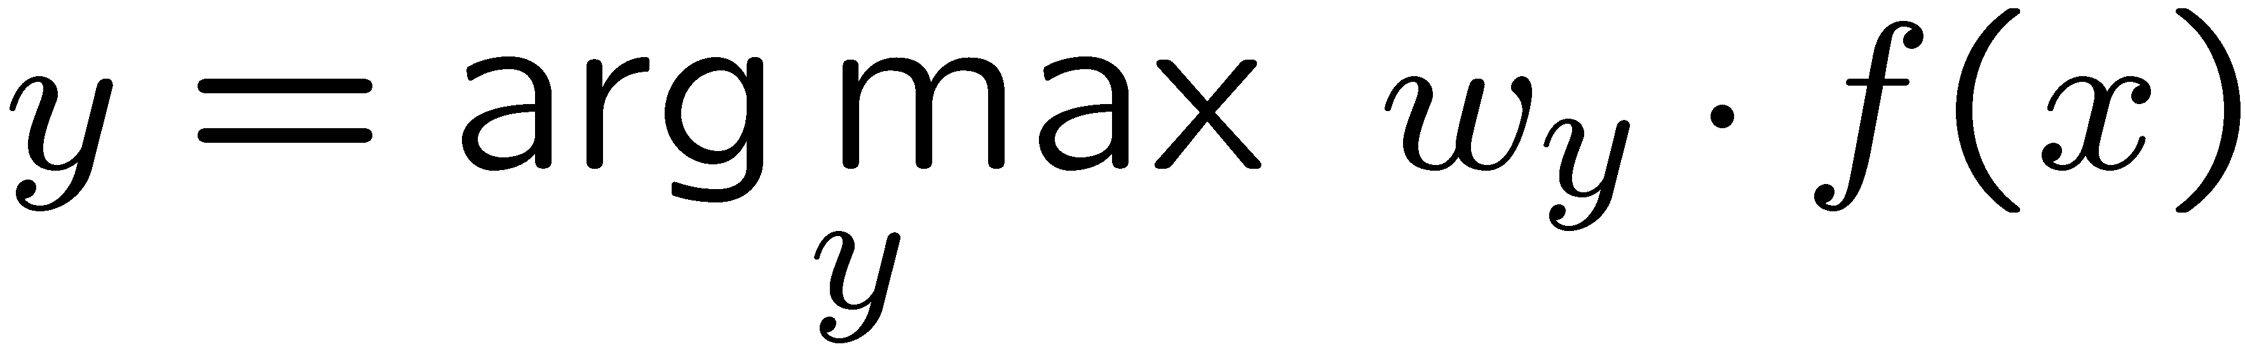
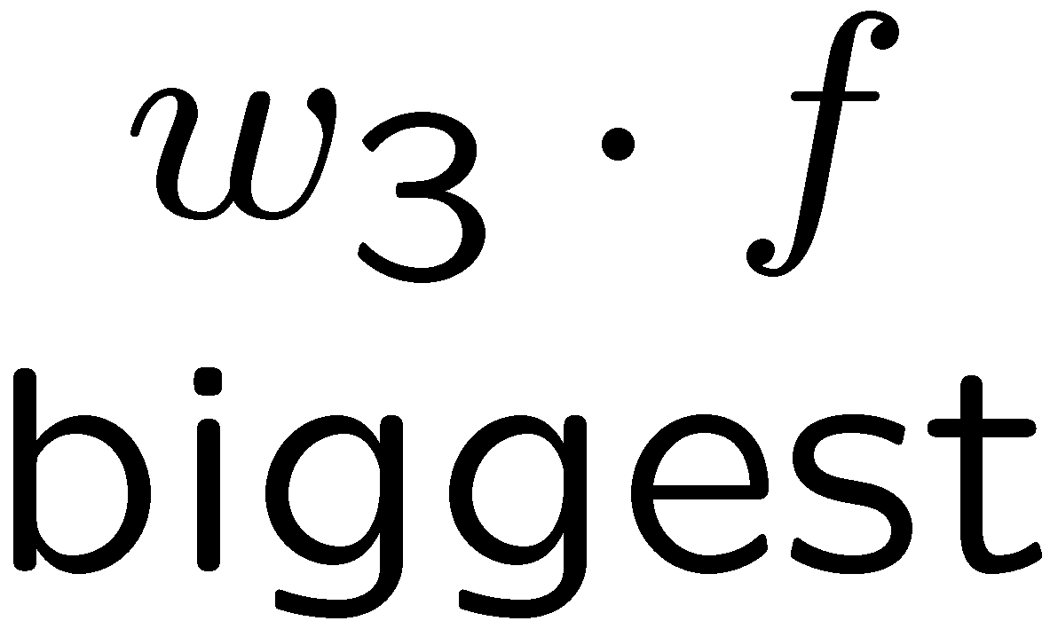
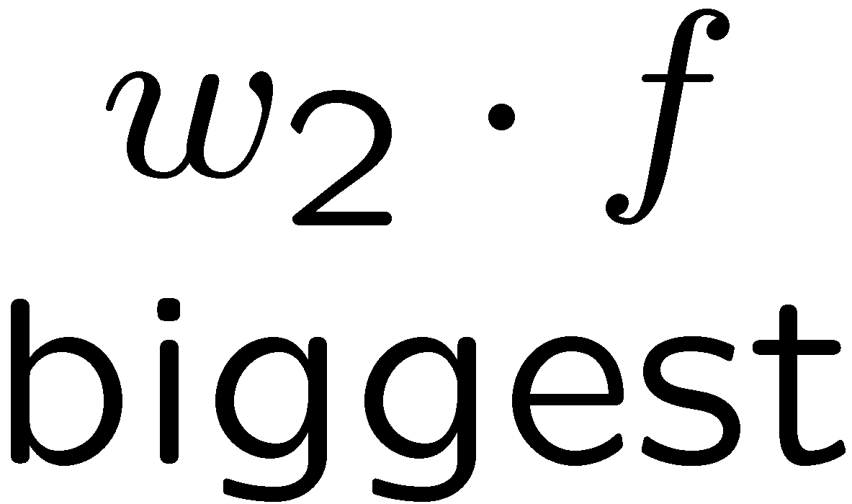
Multiclass Decision Rule
If we have multiple classes:
A weight vector for each class:
Score (activation) of a class y:
Prediction highest score wins
Binary = multiclass where the negative class has weight zero

Slide 18

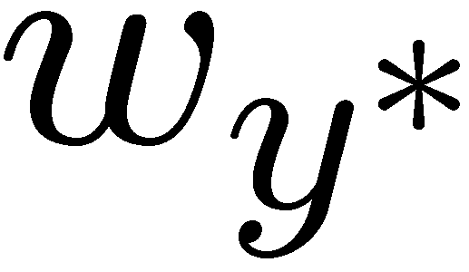

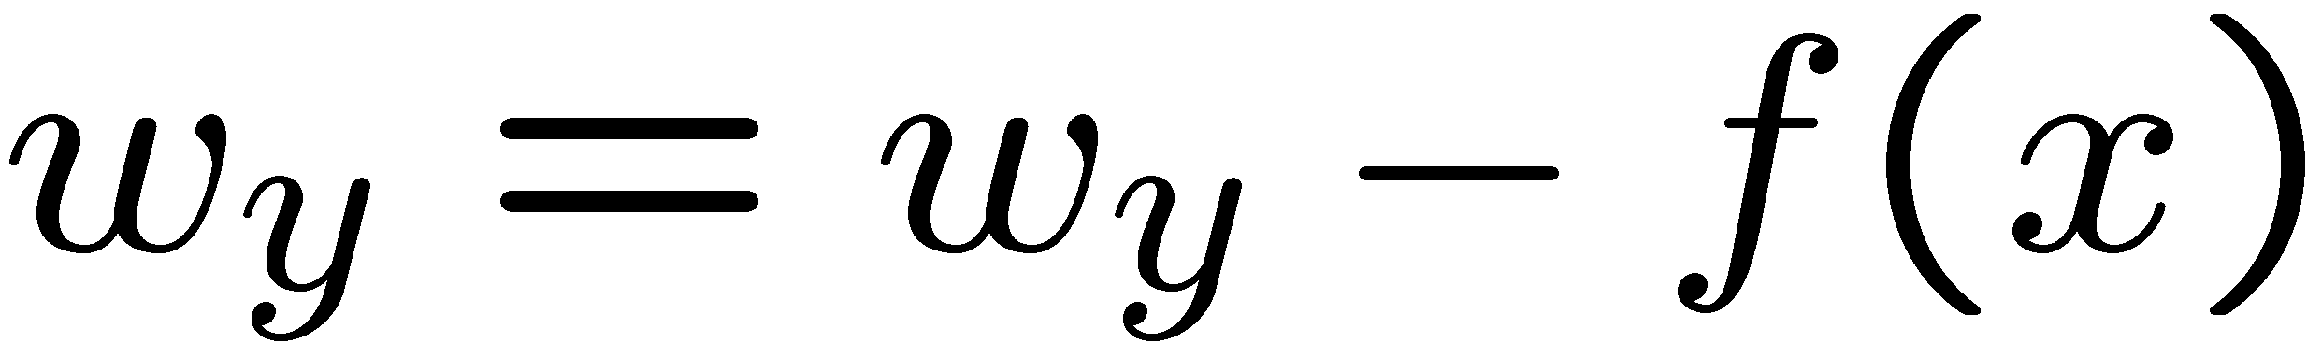
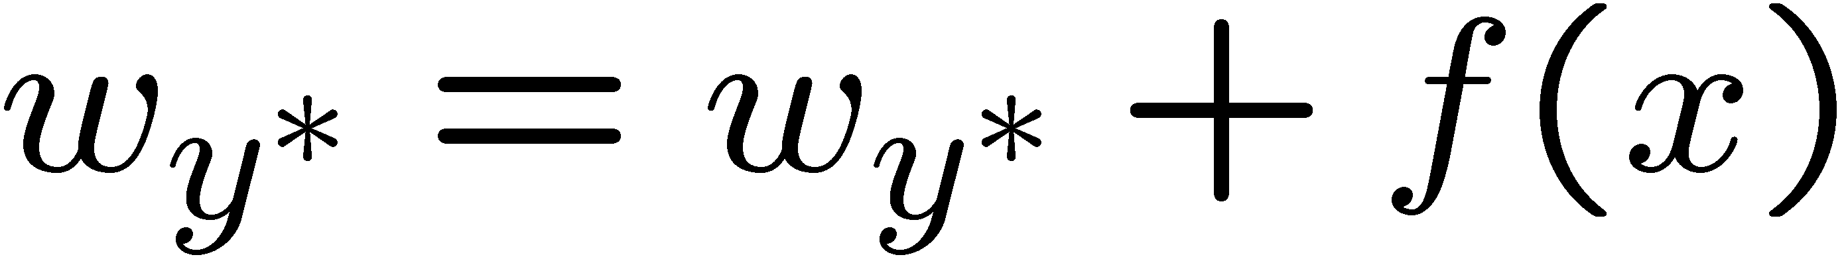
Learning: Multiclass Perceptron
Start with all weights = 0
Pick up training examples one by one
Predict with current weights
If correct, no change!
If wrong: lower score of wrong answer, raise score of right answer

Slide 19



Example: Multiclass Perceptron
“win the vote”
“win the election”
“win the game”
BIAS : 1
win : 0
game : 0
vote : 0
the : 0
...
BIAS : 0
win : 0
game : 0
vote : 0
the : 0
...
BIAS : 0
win : 0
game : 0
vote : 0
the : 0
...

Slide 20
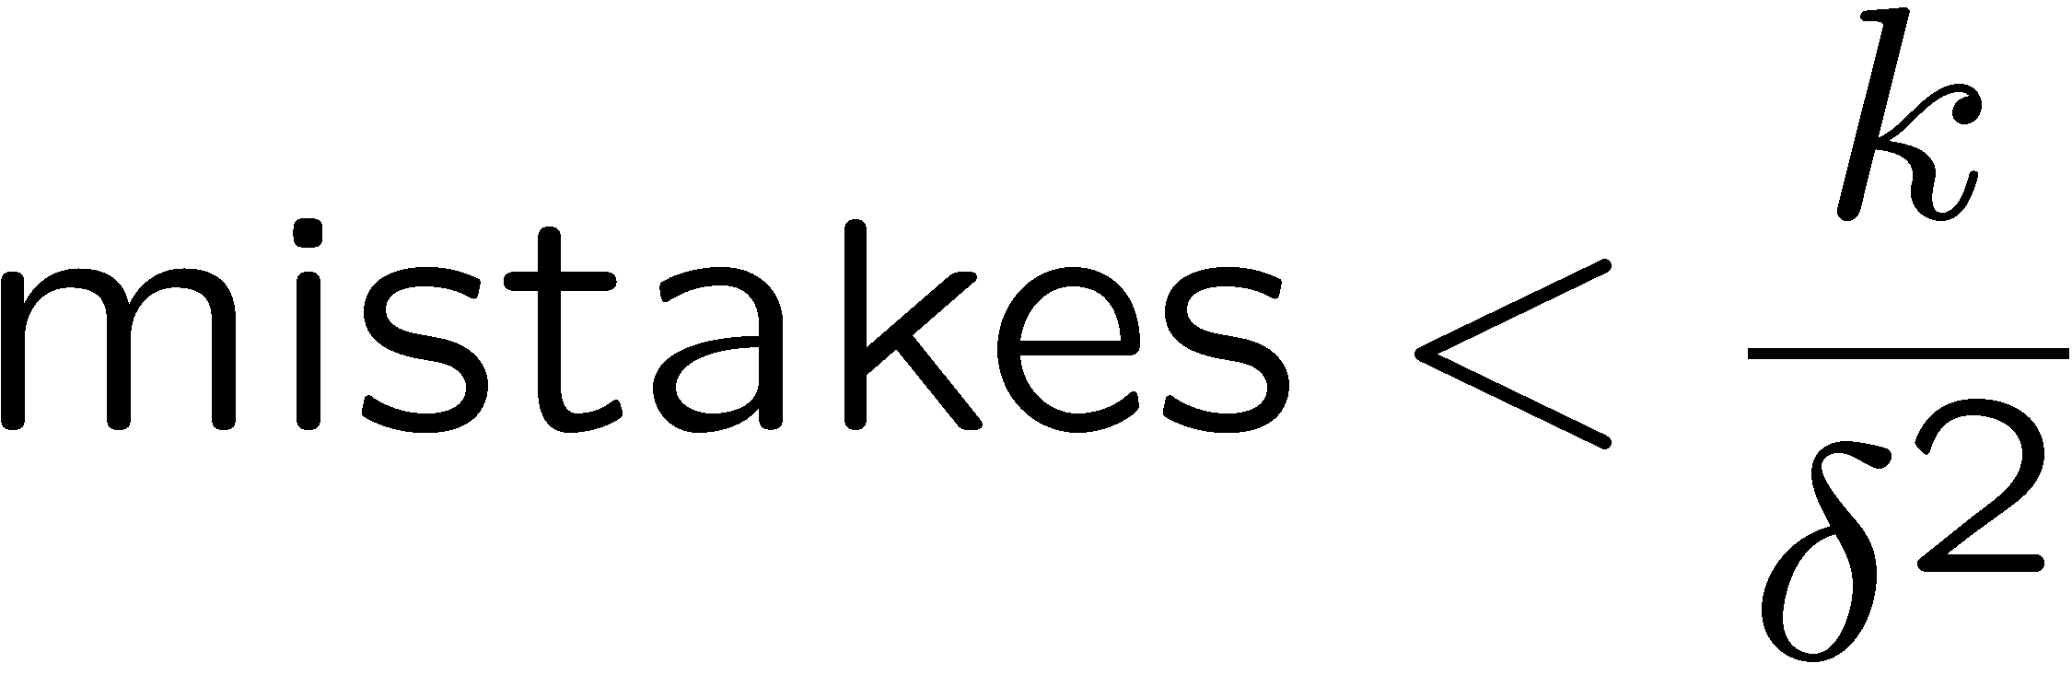
Properties of Perceptrons
Separable
Separability: true if some parameters get the training set perfectly correct
Convergence: if the training is separable, perceptron will eventually converge (binary case)
Mistake Bound: the maximum number of mistakes (binary case) related to the margin or degree of separability
Non-Separable

Slide 21
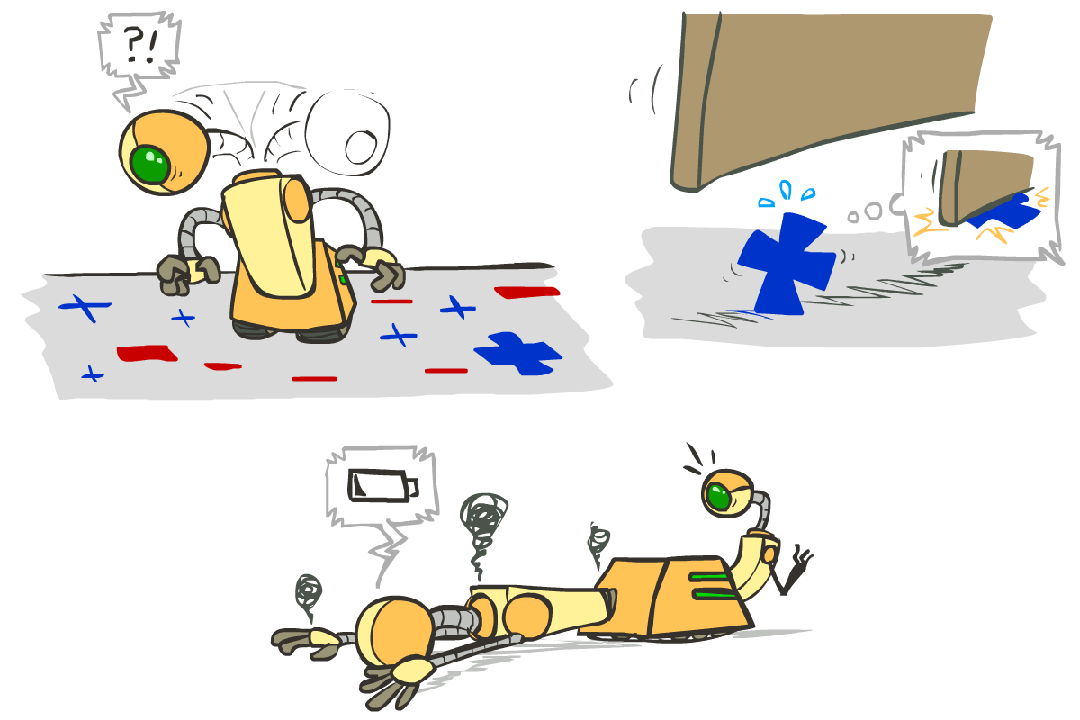





Problems with the Perceptron
Noise: if the data isn’t separable, weights might thrash
Averaging weight vectors over time can help (averaged perceptron)
Mediocre generalization: finds a “barely” separating solution
Overtraining: test / held-out accuracy usually rises, then falls
Overtraining is a kind of overfitting

Slide 22
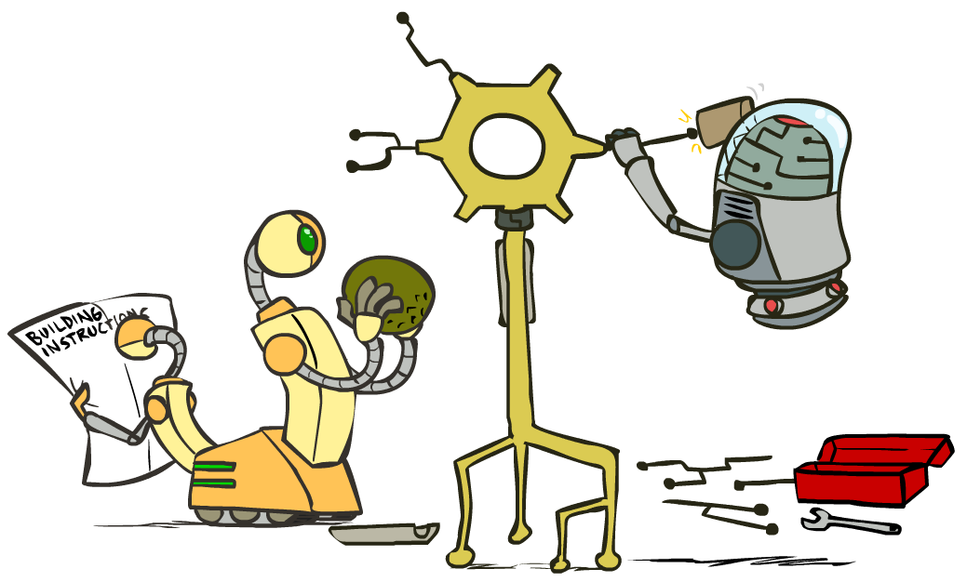
Improving the Perceptron

Slide 23
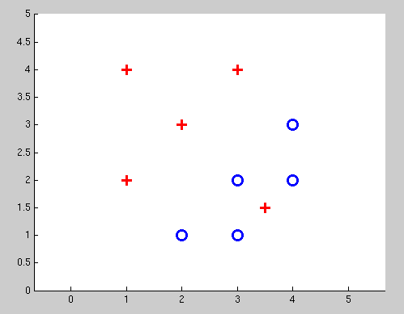
Non-Separable Case: Deterministic Decision
Even the best linear boundary makes at least one mistake

Slide 24
Non-Separable Case: Probabilistic Decision
0.9 | 0.1
0.7 | 0.3
0.5 | 0.5
0.3 | 0.7
0.1 | 0.9

Slide 25
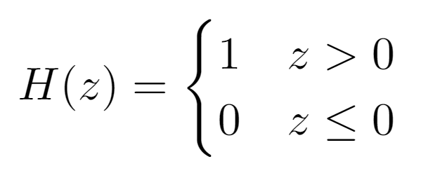
How to get deterministic decisions?
Perceptron scoring:
If positive → classifier says: 1.0 probability this is class +1
If negative → classifier says: 0.0 probability this is class +1
Step function
z = output of perceptron H(z) = probability the class is +1, according to the classifier
H(z)
1
z
0

Slide 26
How to get probabilistic decisions?
Perceptron scoring:
If very positive → probability of class +1 should approach 1.0
If very negative → probability of class +1 should approach 0.0
Sigmoid function
z = output of perceptron = probability the class is +1, according to the classifier

Slide 27
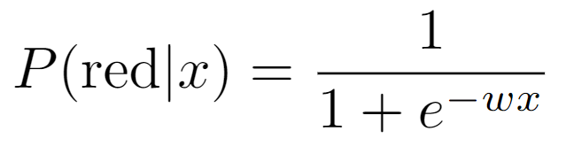



A 1D Example
where w is some weight constant (1D vector) we have to learn
(assume w is positive in this example)
definitely blue
(x negative)
not sure
(x near 0)
definitely red
(x positive)

Slide 28
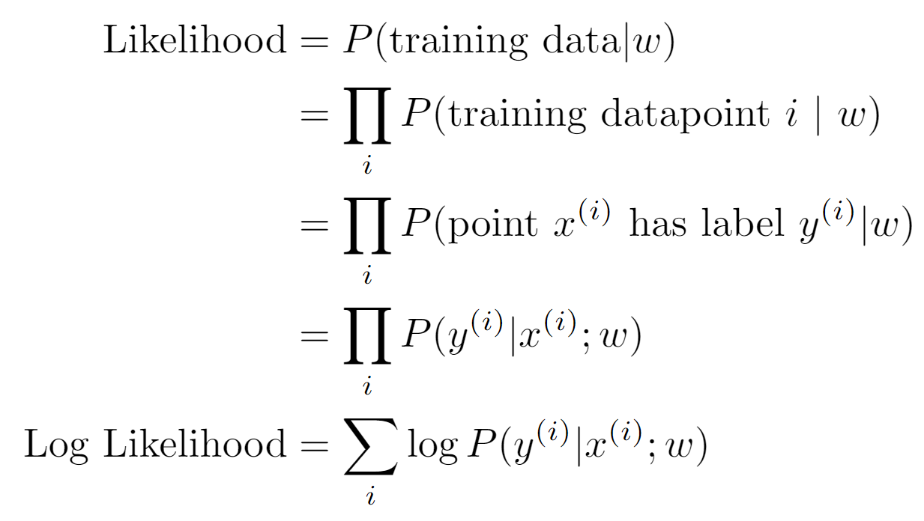
Best w?
Recall maximum likelihood estimation: Choose the w value that maximizes the probability of the observed (training) data

Slide 29
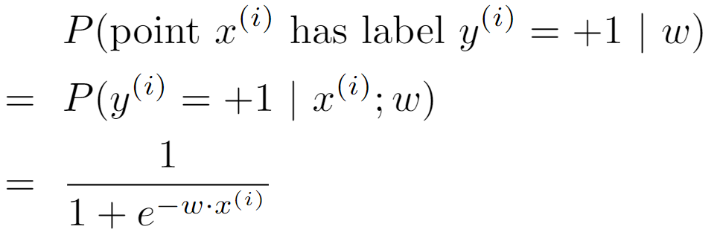
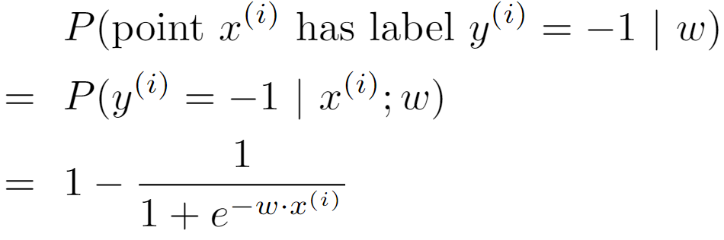
Best w?
Recall maximum likelihood estimation: Choose the w value that maximizes the probability of the observed (training) data

Slide 30
Best w?
Maximum likelihood estimation:
with:
= Logistic Regression

Slide 31
Separable Case: Deterministic Decision – Many Options

Slide 32
Separable Case: Probabilistic Decision – Clear Preference
0.7 | 0.3
0.5 | 0.5
0.7 | 0.3
0.3 | 0.7
0.5 | 0.5
0.3 | 0.7

Slide 33
Multiclass Logistic Regression
Recall Perceptron:
A weight vector for each class:
Score (activation) of a class y:
Prediction highest score wins
How to make the scores into probabilities?
original activations
softmax activations

Slide 34
Best w?
Recall maximum likelihood estimation: Choose the w value that maximizes the probability of the observed (training) data

Slide 35
Best w?
Maximum likelihood estimation:
with:
= Multi-Class Logistic Regression

Slide 36
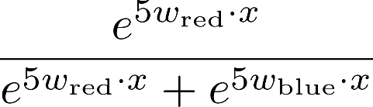
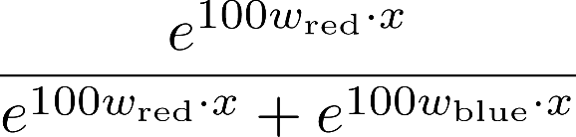

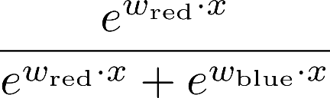
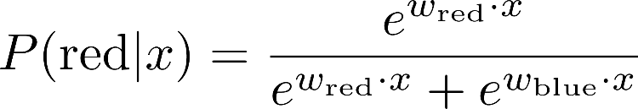
Softmax with Different Bases

Slide 37
Softmax and Sigmoid
Recall: Binary perceptron is a special case of multi-class perceptron
Multi-class: Compute for each class y, pick class with the highest activation
Binary case: Let the weight vector of +1 be w (which we learn). Let the weight vector of -1 always be 0 (constant).
Binary classification as a multi-class problem: Activation of negative class is always 0. If w · f is positive, then activation of +1 (w · f) is higher than -1 (0). If w · f is negative, then activation of -1 (0) is higher than +1 (w · f).
Softmax
Sigmoid
with w_{red} = 0 becomes:

Slide 38
Next Lecture
Optimization
i.e., how do we solve:

